Slide 1

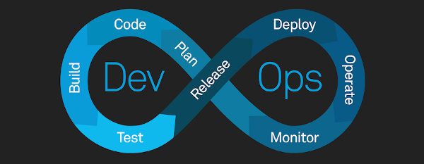
CI/CD
By Mohamed Yasser

Slide 2
Contents
Introduction to CI/CD
Pillars of CI/CD
Advantages of using CI/CD
Added value of CI/CD to our business

Slide 3
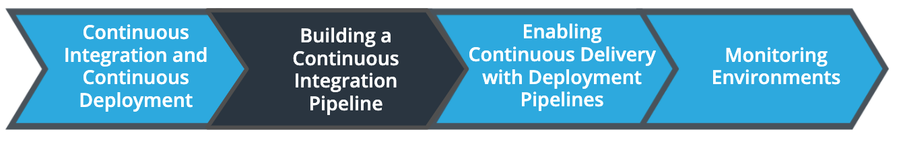
Introduction
What is CI/CD?
  CI/CD is the process of continuous integration and continuous deployment to achieve continuous delivery of our software
  It is divided into 2 sections where the CI carries all rerlated source code compilation and tests while the CD is responsible for infrastructure creation and provisioning as well as smoke tests and promoting the software to production stage
  it is a process that helps deliver content to our customers more frequently

Slide 4
Pillars of CI/CD
Continuous Integration
  Allows for a unified build process where development team members can work on separate branches and push the correct final code to the master branch(source control)
  Provides faster automated unit tests and integration tests
  Create re-usable jobs to use in various integrations
  Automated vulnerabilities checks
Continuous Deployment
  Abstraction of infrastructure with the ability to create infrastructure as a code
  Allow for making smoke tests to test our deployments
  Provisioning and rollback jobs in case we need to go back to an earlier version
  Promoting software to be ready for production

Slide 5
Advantages of using CI/CD
Automation of tasks
Decreasing Human Errors
Catching compile errors in a faster and easier manner
Remove the need for manual check before deploying for production

Slide 6
Added value of CI/CD to our business
Less resources are needed since many tasks are automated and therefore decreased cost
Faster and more frequent deployment and hence increased revenue
Automation of tasks allow for less time needed to make the software available for market and hence increased revenue
Detection of security vulnerabilities and solving them hence avoiding costs from security breaches
Automation of infrastructure creation and cleanup which enable faster deployment with no human error and hence reduces and avoids additional costs

